Slide 1
Open Doors, Open Data: Winning Public Trust by Running Transparent, Data-Driven Project Planning
Lauren Palmer, Director of Local Government Services, Mid-America Regional Council, ICMA-CM
Dante Hall, City Manager, Hercules, CA
Jeff Reiter, Assistant City Administrator, Bettendorf, IA
Eyal Feder-Levy, CEO & Co-founder, Zencity

Slide 2
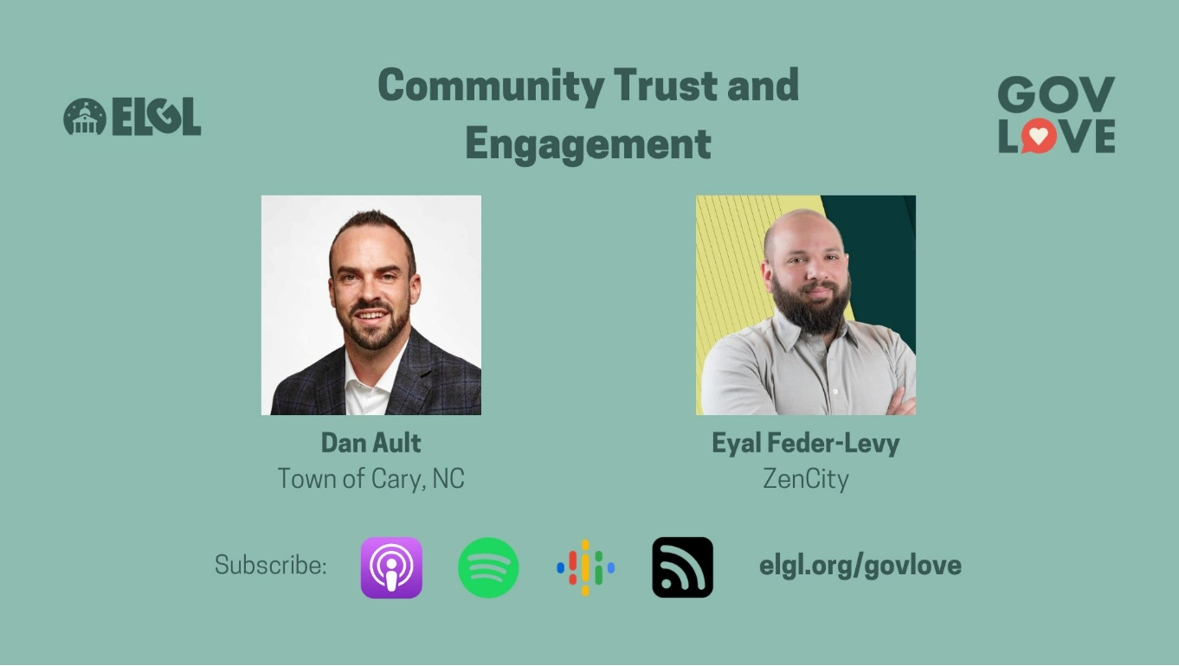

Slide 3
300+ government organizations
use Zencity every day to
improve services, increase satisfaction & build trust
The platform allows us to understand the needs and concerns of our residents to make the best decisions.
Todd Gloria, San Diego Mayor

Slide 4
Building trust with your community is the key to success
“Trust helps government connect with residents and encourages voluntary compliance with rules and regulations.”
Deloitte Center for Government Insights

Slide 5
Trust in government is at historic lows.
Only 1 in 3 Americans have high trust in their state and local government
~10% drop of Americans’ trust in local government to handle local problems
42% trust score
Government leaders are the least trusted societal leaders
with a 42% trust score
State Policy Network Research, May 2023
Gallup, 2021
Edelman Trust Barometer, 2022

Slide 6
To build trust you need to
Accurately understand your community’s diverse needs and priorities
Civic engagement is the most important factor in building trust in our institutions, and our communities need to find better ways to encourage active participation in civic life.”
Erin Norman, State Policy Network

Slide 7
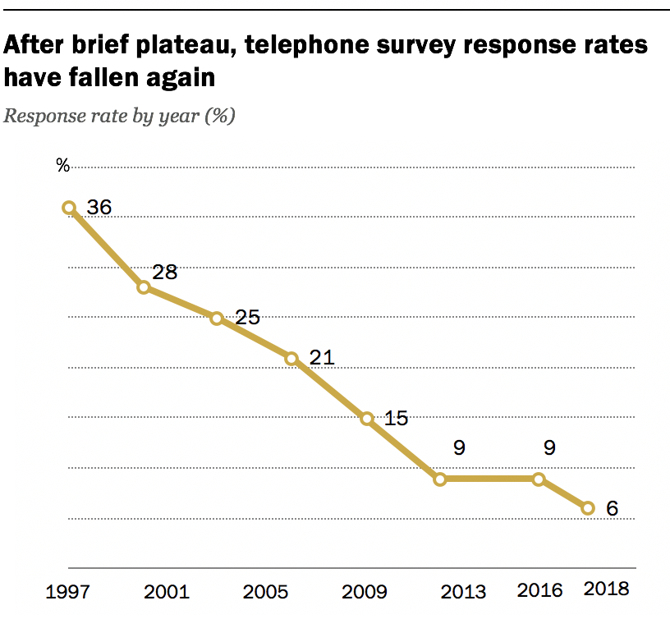
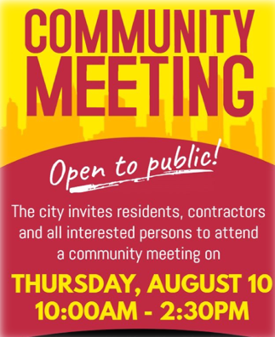
Current methods of community engagement are limited, giving you a skewed view of resident needs and priorities.
64%
6%
Of public meeting attendees oppose new projects or plans
Response rate to phone surveys
PEW Research, 2018
BU Study, 2018

Slide 8
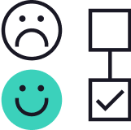
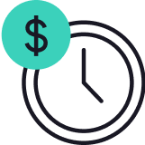
Community engagement is broken
It’s hard to reach beyond the STPs
No clear understanding of residents’ needs and priorities
It’s difficult to build community trust
It requires significant effort & resources

Slide 9
A complex problem requires
a comprehensive solution,
built for our time.
Everyone is online
>93% Of US adults use the internet
A multi-model approach
Combining passive and proactive tools is required to ensure effective engagement
AI productivity boom
Average productivity growth through use of AI is 66%
PEW Research, 2021
The Responsive City Cycle Report, 2022
Nielsen Research Group, 2023

Slide 10
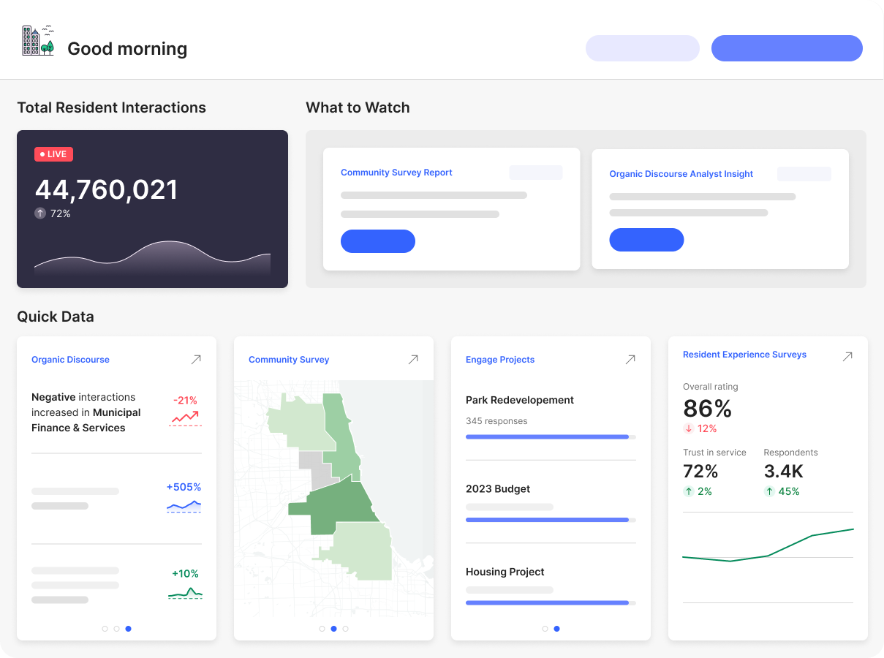
Introducing - the Zencity 360 Platform Understanding community needs and concerns. Making decisions. Building trust.
Performance Management
Public Safety & Trust
Sentiment analysis
Messaging & Communications
Community surveys
Annual & Strategic Planning
Digital engagement
Capital Projects
Budget & Resource Allocation
Experience surveys
Collect Input
Analyze
Build Trust

Slide 11
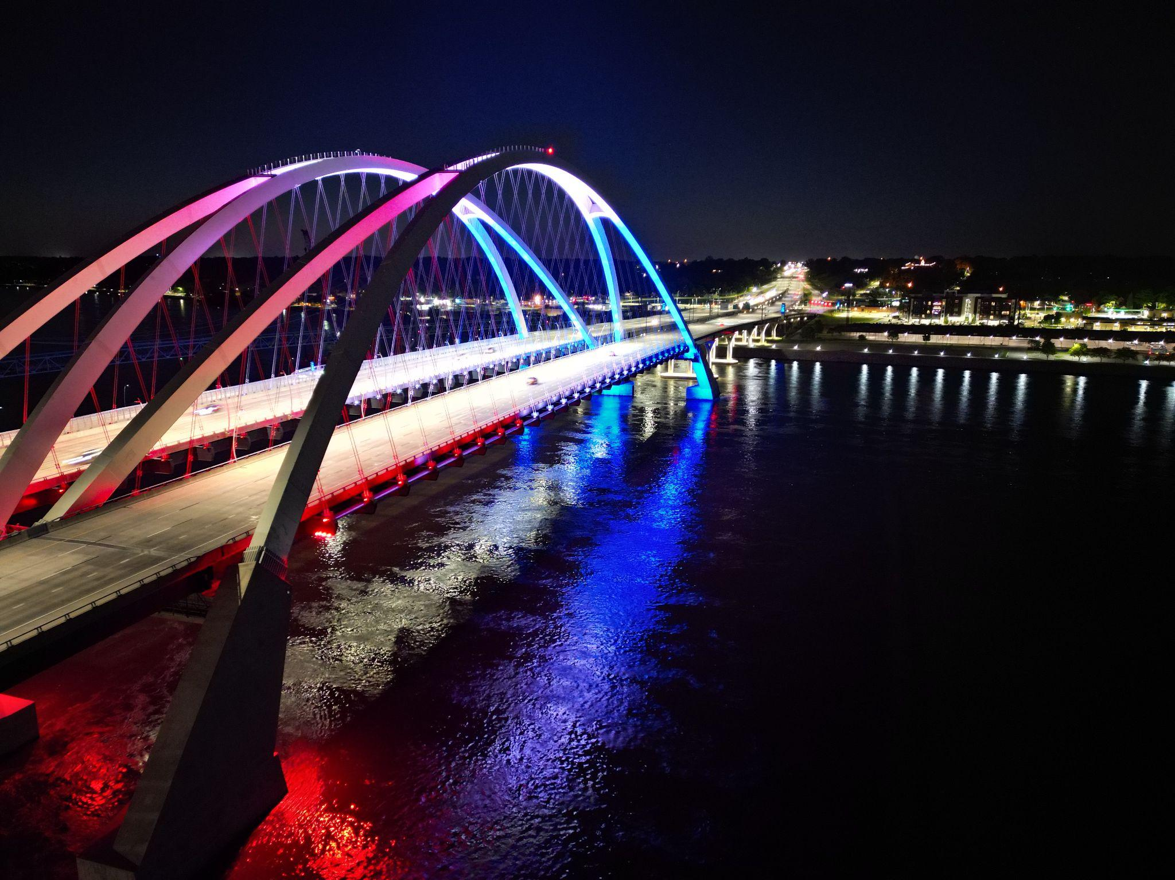
Bettendorf, IA
Using Data to Transform Your Parks

Slide 12
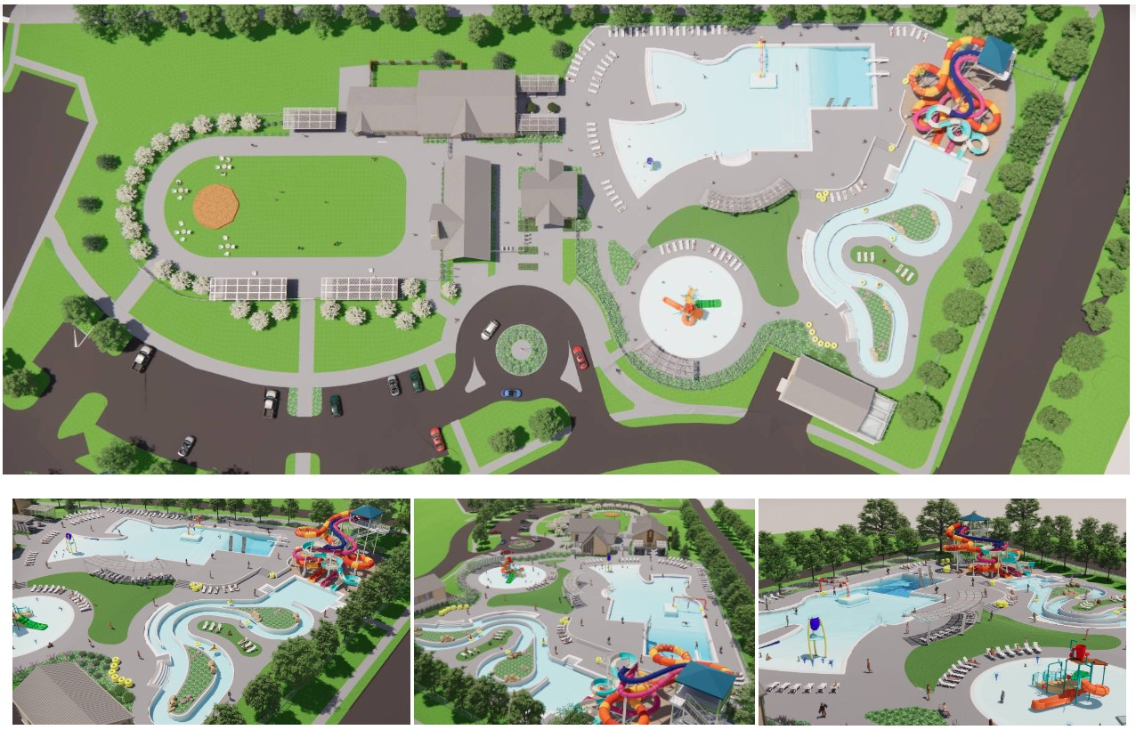
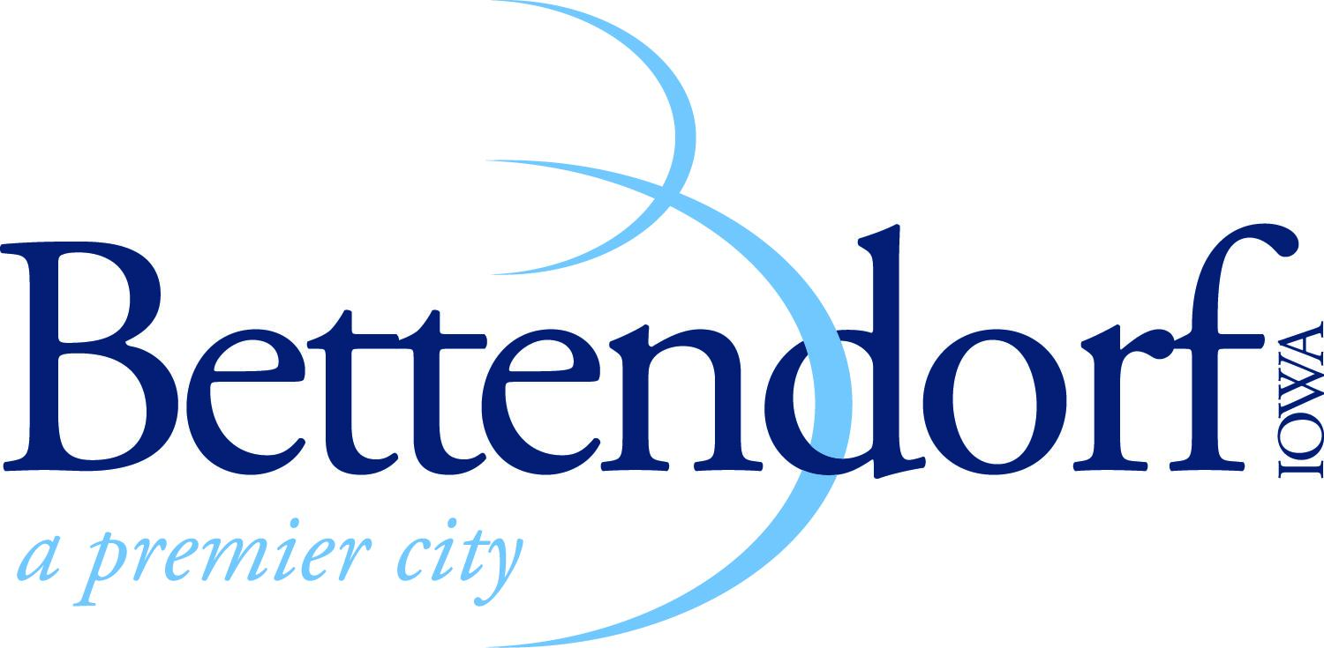
The Landing
Bettendorf’s New
Aquatic Facility
and Ice Rink

Slide 13
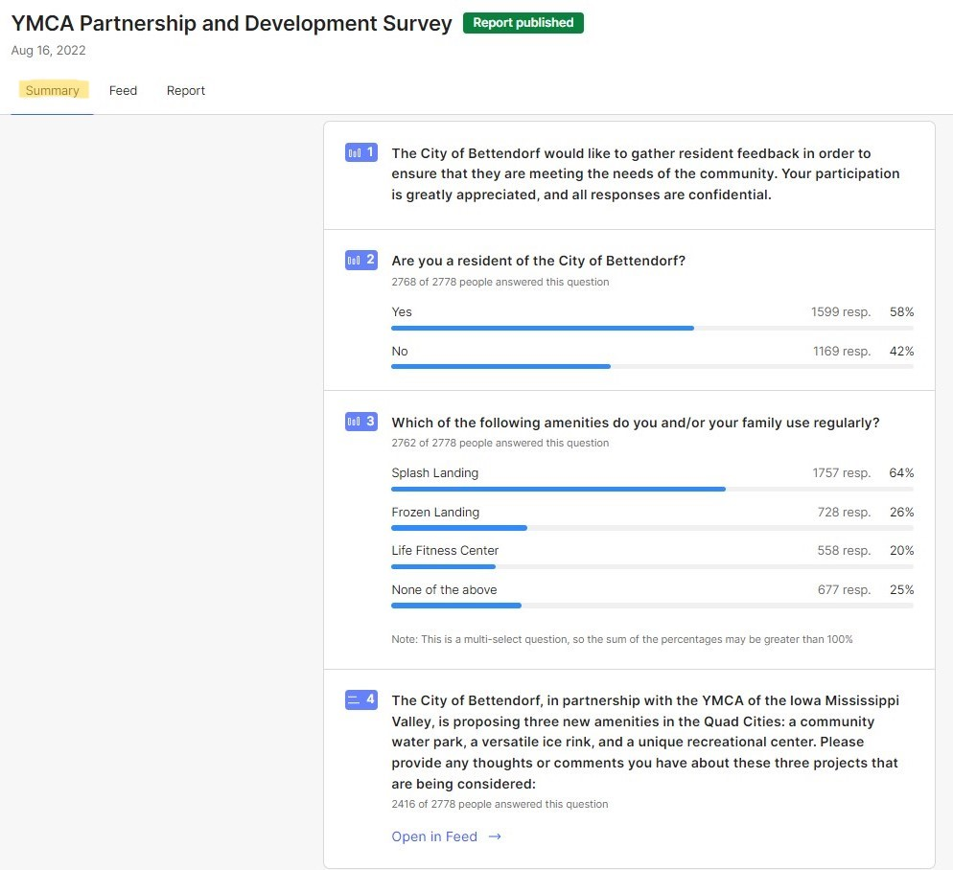
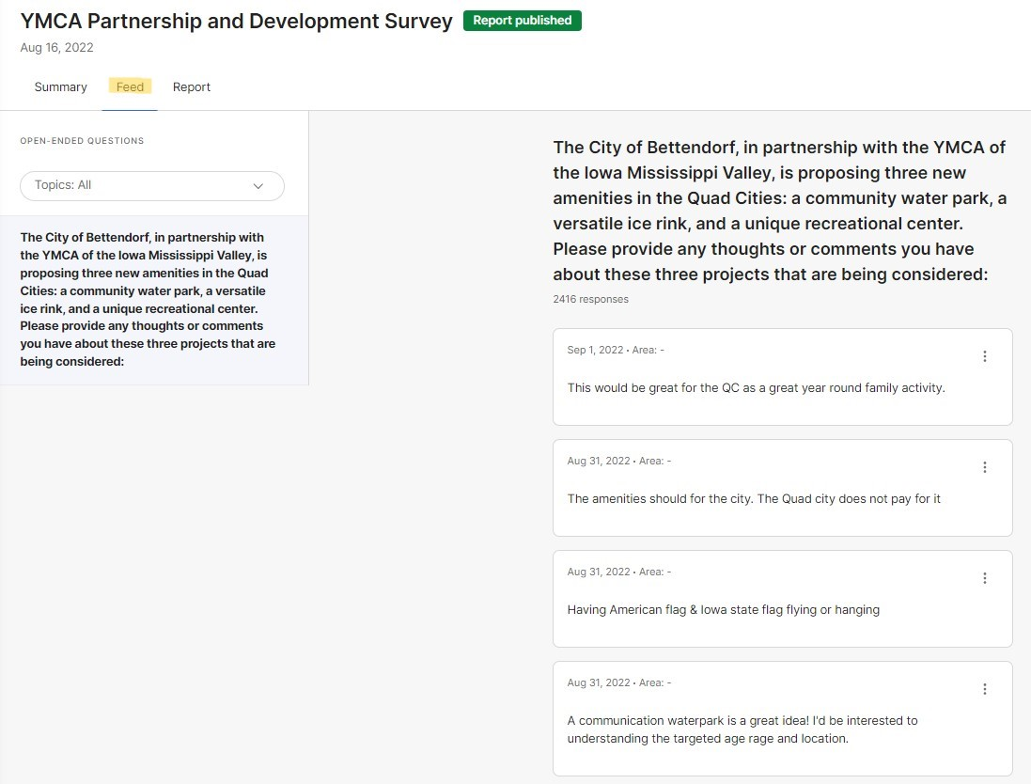
Survey Your Constituents
Involving them in the process builds trust and advocacy

Slide 14
Report Back to Your Constituents

Slide 15
Report Back to Your Constituents
Notes:
As an example of the “change” we made in messaging, we took comments from the engagement we were receiving, and we incorporated it into a running timeline for everyone to see on our website. This timeline keeps people informed and it is still relevant and on our website today. This screenshot captures a snapshot of that timeline, and as you will see, there is a small image of our “Mayor’s Message” video that we do every Friday. On this particular Friday, Mayor Gallagher interviewed our City Engineer and gave the community a video update of the progress, while also answering some common questions that we were repeatedly getting from the public. This was all done in response to the communications and engagement tools through ZenCity.

Slide 16
Hercules, CA
Parks & Facilities Master Plan

Slide 17
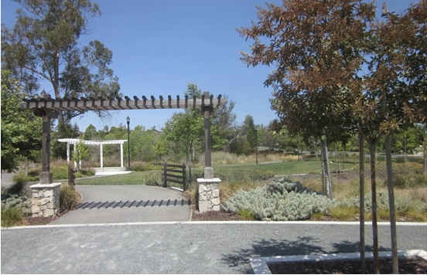
Purpose of the Master Plan
To support fiscal sustainability through effective park and facility planning, the Parks and Recreation Facilities Master Plan will identify park improvements, facility enhancements, programming options, and accessibility (ADA) needs to create a prioritized park investment strategy for the next 10 years.
This planning process will:
Identify community priorities
Identify needs for parks, outdoor and indoor recreation facilities, and programs
Create a prioritized capital improvement plan
Identify cost efficiencies and funding strategies

Slide 18
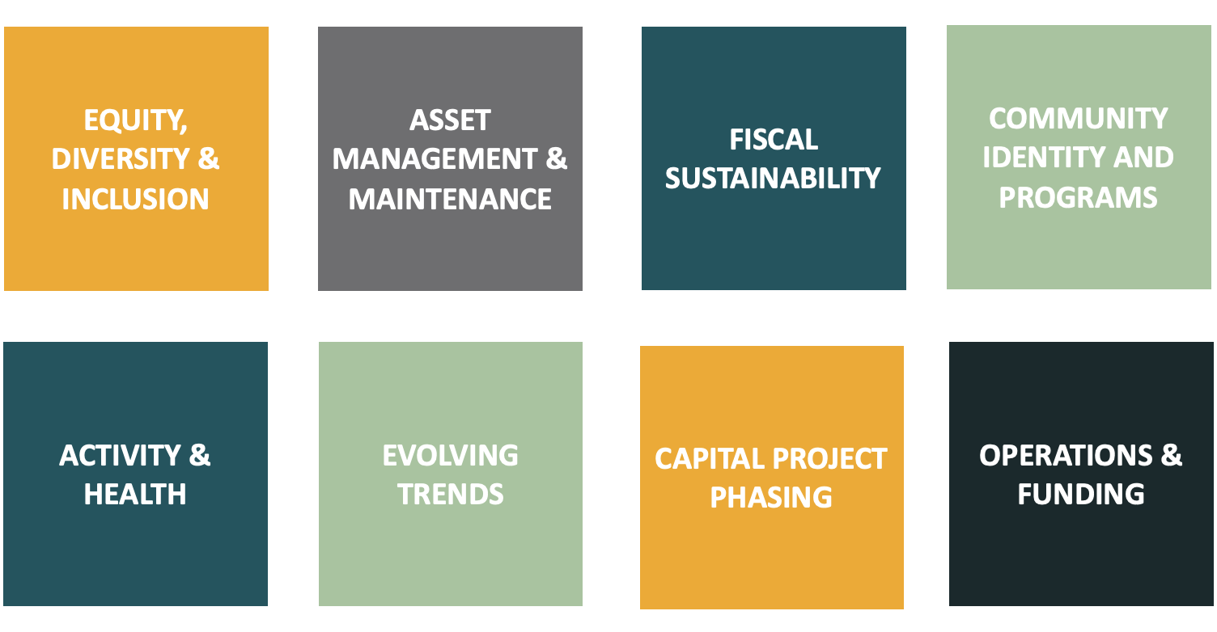
Evaluation Lenses

Slide 19
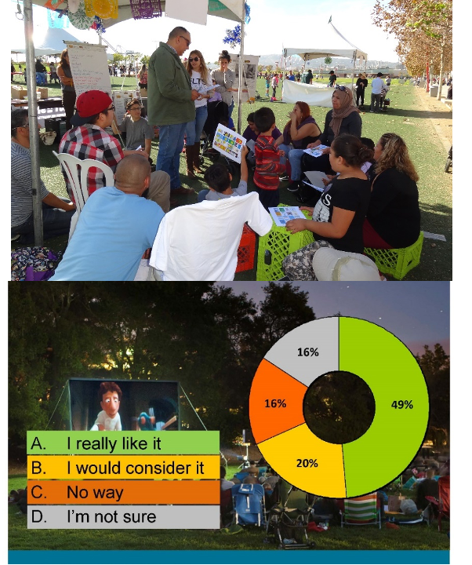
Outreach and Engagement Goals
Ensure the plan reflects diverse community priorities.
Involve as many people as possible.
Involve people who do not normally participate in the planning process.
Document community preferences for park investment.
Foster long-term support for parks and recreation.

Slide 20
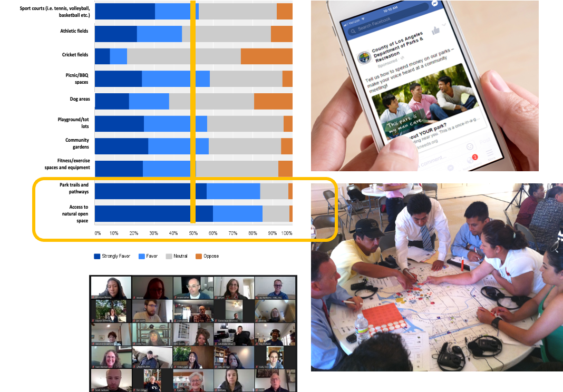
Engagement Opportunities
Create dedicated website to advertise events/opportunities, email sign up, and learn about the process
Solicit community input through an online survey
Hold in-person community workshop to identify needs and priorities
Engage underrepresented groups through focus group meetings (Community Connections events)

Slide 21
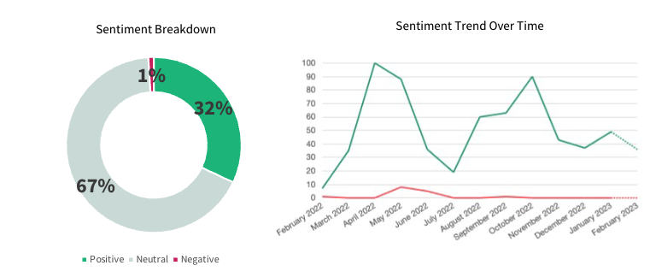
Online Discourse
Analysis
In order to:
Learn what’s going on organically
2,100 online interactions analyzed
Overwhelmingly positive sentiment
After-school activities, main topic of conversation

Slide 22
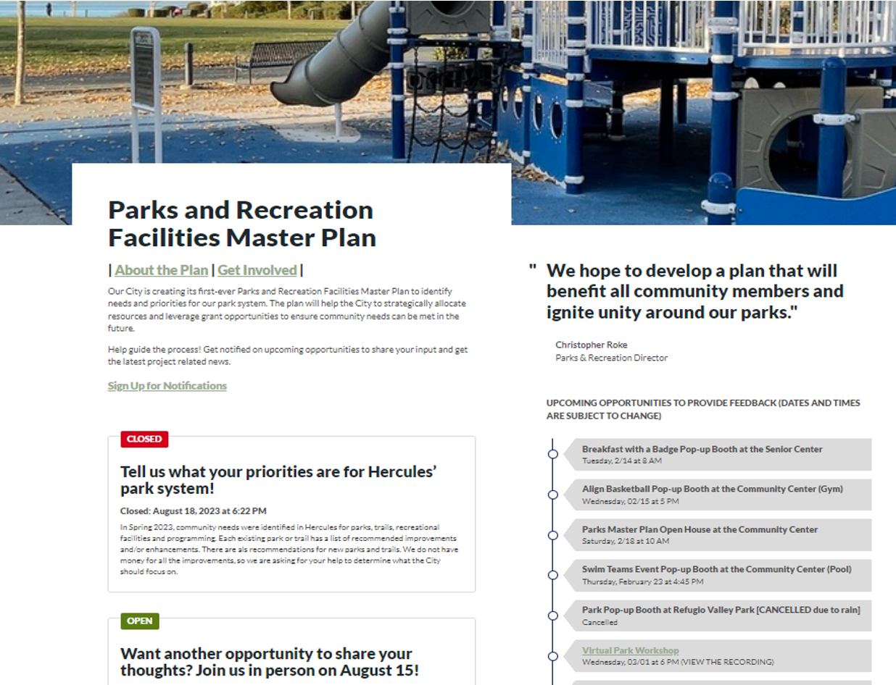
Parks Master Plan Website
489 Survey responses through the engagement hub

Slide 23
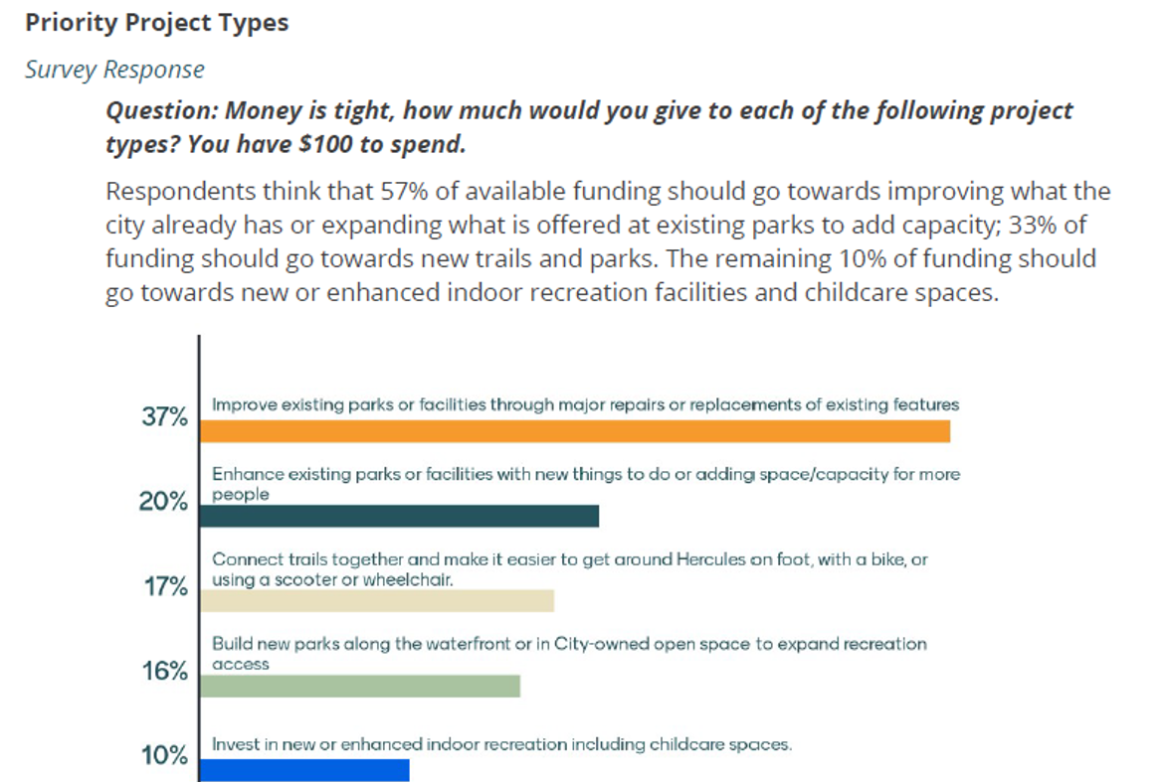
Online
Survey
Findings

Slide 24
Masterplanning
Process

Slide 25
Q&A

